Slide 1
Internet Engineering Task Force Newcomers’ Overview
November 2018
Notes:
Introduce all Edu Team member on the webinar or in the room
Mention the chat room and that we will post all URLs in there
Encourage participants to ask questions to ask questions after each section (“raise hand” in chat room)
Define Newcomers: attended up to five meeting
Define Firsttimers: this is their first meeting

Slide 2
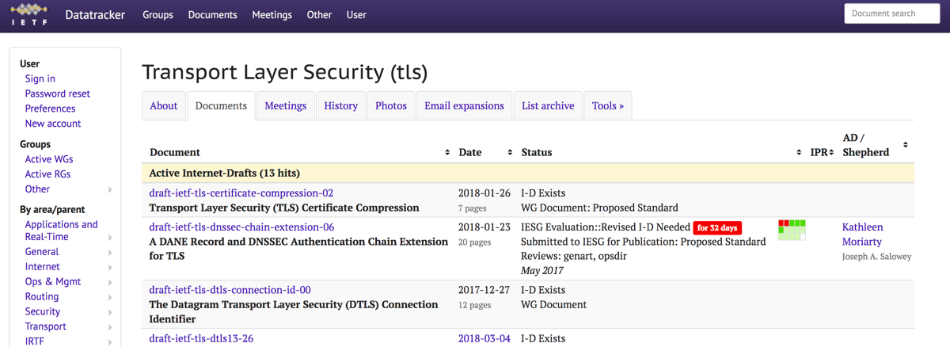
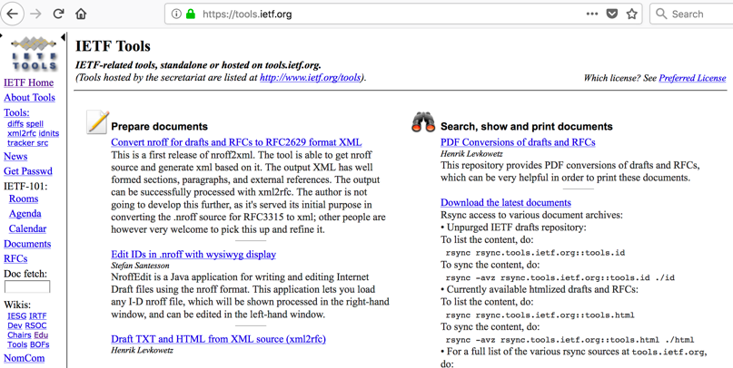
Information
IETF Datatracker https://datatracker.ietf.org/
Tools Page https://tools.ietf.org/
Notes:
NOTE: I moved this slides to the front so people can practice how to get to the datatracker and find the slides for this tutorial.
You need to guide them through it.

Slide 3
https://www.ietf.org/
Welcome to the IETF!
Thanks to Scott Bradner and Mike St.Johns for earlier versions of this presentation.
Notes:
There will be three sections to this presentation:
Introduction to Newcomers activities at the IETF meeting
Introduction to the IETF structure and related organizations
The IETF week in a nutshell
Key people and additional resources
Feel free to ask questions after each section.

Slide 4
https://www.ietf.org/about/note-well/
IETF Note Well
This is a reminder of IETF policies in effect on various topics such as patents or code of conduct. It is only meant to point you in the right direction. Exceptions may apply. The IETF's patent policy and the definition of an IETF "contribution" and "participation" are set forth in BCP 79; please read it carefully.
As a reminder:
By participating in the IETF, you agree to follow IETF processes and policies.
If you are aware that any IETF contribution is covered by patents or patent applications that are owned or controlled by you or your sponsor, you must disclose that fact, or not participate in the discussion.
As a participant in or attendee to any IETF activity you acknowledge that written, audio, video, and photographic records of meetings may be made public.
Personal information that you provide to IETF will be handled in accordance with the IETF Privacy Statement.
As a participant or attendee, you agree to work respectfully with other participants; please contact the ombudsteam (https://www.ietf.org/contact/ombudsteam/) if you have questions or concerns about this.
Notes:
This and the following slide are the IETF Note Well that applies to all IETF participation. By participating in the IETF in person or remotely, you agree to these policies.
You don’t have to read all this right now. But you will see this text a lot during the IETF week (at the beginning of all WG session). It is important for you to read this before you participate (see link on top of the slide).

Slide 5
https://www.ietf.org/about/note-well/
IETF Note Well (cont.)
Definitive information is in the documents listed below and other IETF BCPs. For advice, please talk to WG chairs or ADs:
BCP 9 (Internet Standards Process)
BCP 25 (Working Group processes)
BCP 25 (Anti-Harassment Procedures)
BCP 54 (Code of Conduct)
BCP 78 (Copyright)
BCP 79 (Patents, Participation)
https://www.ietf.org/privacy-policy/ (Privacy Policy)
Notes:
This is still part of the IETF Note Well. It lists a number of documents that all IETF participants agree to follow. Please make sure you are familiar with these documents.

Slide 6
https://www.ietf.org/how/meetings/102/newcomers Newcomer Activities @ IETF 103
Newcomer’s tutorial (12:30 – 13:30, Sunday, 4 November)
IETF Quick Connections (15:00 – 16:00, Sunday, 4 November)
Short one-on-one conversations with experienced IETFers
Newcomer’s Meet and Greet (16:00 - 17:00, Sunday, 4 November)
Newcomers and IETF Leadership (WG Chairs, ADs, IAB)
Mentoring https://www.ietf.org/about/participate/mentoring/
Newcomer’s Dinner (Monday evening, 5 November)
Newcomers Feedback session (08:15 – 09:15, Thursday, 8 November)
Notes:
There are a number of events organized specifically for IETF Newcomers early in the week. Please try to attend as this will make it easier for you during the rest of the week.
All information can be found here: https://www.ietf.org/how/meetings/103/newcomers/

Slide 7
https://www.ietf.org/about/participate/
Scope: Preparing for an IETF Meeting
This presentation includes:
Information immediately useful to you as you attend your first(ish) IETF meetings
Strategies to make the most of the meeting (whether in person or remote)
This presentation does not include information about:
The history of the IETF; How to write a “standard”; and many other things…
The IETF YouTube channel has a playlist with information about all these topics (and more: https://www.youtube.com/playlist?list=PLC86T-6ZTP5hXPJ-n4mwJbZ0BHaNlhTMA
Notes:
The primary purpose of this presentation is to give you the information you need to begin active participation in the IETF.
We hope the information will help you to survive the week.
There is a lot more to learn about the IETF, for instance its history, how to write a standards and much more.
But it would be too much to squeeze into an hour. And it is not essential to know all this at your very first meeting.
Are there any questions at this point?

Slide 8
The IETF and Related Organizations
Notes:
In the next section we will give a quick overview of the structure of the IETF and the main groups and organizations that are part of the IETF “eco system”.

Slide 9

https://www.ietf.org/about/mission/
IETF Mission
The mission of the IETF is to make the Internet work better by producing high quality, relevant technical documents that influence the way people design, use, and manage the Internet. [RFC 3935]
Notes:
First and foremost, what is the mission of the IETF (Read it out).
The means, the purpose of the IETF is defined as follows:
Develop and maintain standards for technologies used to provide Internet service or to provide services over the Internet
Ensure that the technology can perform needed functions
Ensure that the technology will support the proper scale of deployment and usage
Ensure that the technology itself is secure and can be operated securely
Ensure that the technology can be deployed effectively
In short: standards and technology developed at the IETF is secure, scalable and can be deployed effectively.

Slide 10
The IETF is …
A Standards Development Organization (SDO)
With self-selected individual participants, no formal membership
No formal voting (but we do hum…)
No formal government role
Driven by market-based adoption (a real standard is one people use)
Focused on Internet technologies
Bottom-up… and unique!
Notes:
The IETF is a little different than other standards development organizations you might have encountered.
At the IETF people participate as individuals, there is no formal membership. Other SDOs typically have membership in some form – rarely individuals.
At the IETF we don’t have formal voting (but we “hum” – we will get back to that later in this tutorial). Other SDOs typically have some form of formal voting.
There is not formal or special role for governments (or companies for that matter). Everyone is participating as individual. Other SDOs are sometimes treaty-based.
At the IETF a standard is a standard when people (the market) uses them. Adoption of standards is not mandated.
The IETF focuses on Internet technologies. There are other SDOs that cover a wide range of technical, process & physical standards.
The IETF structure and decision making is bottom-up which is fairly unique.

Slide 11
IETF Areas
Applications and Real-Time (ART)
Transport (TSV)
Security (SEC)
General (GEN)
Application protocols and architectures
Real-time (communication) and non-real-time
Network management
Operations: IPv6, DNS, security, routing
Security protocols and mechanisms, including cryptography
Activities focused on supporting and updating IETF processes
Routing and signaling protocols
Internet (INT)
Operations and Management (OPS)
IPv4/IPv6, DNS, DHCP, VPNs, mobility
Mechanisms related to data transport on the Internet
Includes congestion control
Routing (RTG)
Notes:
Work in the IETF is organized into areas of related work. Each area is managed by two or three area directors, except the GEN area which is owned by the IETF Chair.
At the moment we have seven areas. That are listed on this slides.
The number and focus of areas can change over time. Sometime two areas merge or a new one gets created.

Slide 12
The IETF and Consensus
IETF mantra:
“We reject kings, presidents and voting. We believe in rough consensus and running code.”
Rough consensus is achieved when all issues are addressed, but not necessarily accommodated
Dissenting opinions are heard, but are not controlling
Humming: a way of measuring consensus that is not voting
Session chair is responsible for building consensus
WG mailing list consensus has to be taken into account
“On Consensus and Humming in the IETF”, P. Resnick, https://tools.ietf.org/html/rfc7282
Notes:
Consensus is key at the IETF. As mentioned before, there is no formal voting at the IETF. This is really important to understand, it is one of the key features of the IETF as stated in its original mantra:
“We reject kings, presidents and voting. We believe in rough consensus and running code.”
Now, rough consensus is an interesting concept. It doesn’t necessarily means everyone agrees in the end. It is also not necessarily a compromise.
Rough consensus is reached when all concerns and issues are heard and addresses.
They are not necessarily all have to be accommodated – as long as everyone “can live with the outcome”.
The session chair is responsible to lead the discussion and make sure all dissenting opinions are heard (but they should not be the controlling voice).
We measure consensus by humming (explain humming). It is a good way to “feel the temperature of the room”. And it is anonymous. Nobody is raising their hand in order to make their choice know.
It is also important to note that a consensus call is usually carried over to the mailing list (and basically repeated on the mailing list), so that those who could not attend the meeting are also heard.
RFC 7282 is a great read. We recommend it for everyone to read.

Slide 13
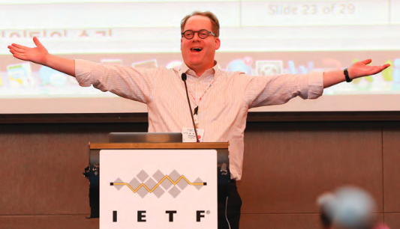

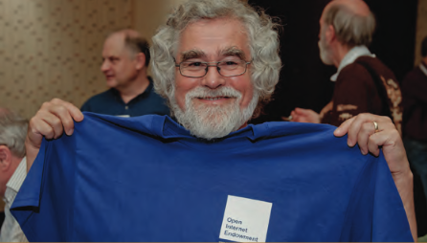

IETF Culture
Technical excellence
is highly valued
Passionate, smart,
vocal people
Close working relationships
(people know each
other)
Informal dress code
(people LOVE t-shirts)
Notes:
As mentioned earlier, the IETF culture is fairly unique in many aspects:
People tend to be passionate, smart and vocal. This can be a little overwhelming sometimes, but they are usually really trying to find the best solution.
Technical excellence and topical knowledge is highly valued. Please make sure you have read the relevant documents before you make a comment at the mic.
The IETF culture and also its dress code is very informal. T-shirts are the usual dress code.
Many people know each other for many years which makes for a great “familiar” atmosphere. But it can also mean that there is a bit of an “in-crowd language” sometimes.
Don’t feels intimidated! Introduce yourself to others and try to have a good time.

Slide 14
Alphabet soup
Internet Engineering Steering Group
Internet Architecture Board
Internet Research Task Force
IETF Administrative Support Activity
IETF Administrative Oversight Committee
IETF Administrative Director
Internet Society
Notes:
There are several other bodies that interact with the IETF. This presentation focuses only on the aspects of these organizations and activities that are immediately relevant to IETF newcomers.
Internet Architecture Board (IAB)
Internet Research Task Force (IRTF)
IAB Programs
RFC Editor
IETF Administrative Support Activity (IASA)
IETF Administrative Oversight Committee (IAOC)
IETF Trust
The next slides lists the tasks of these organizations.

Slide 15
Who does what?
IAB: provides oversight of the Internet architecture and the standards process
IESG: responsible for technical management of IETF activities and the Internet standards process
IRTF: a parallel organization focused on longer-term research topics for the Internet
IAOC: is responsible for the fiscal & administrative support of the IETF standards process
Notes:
Are there any questions at this point before we move on to the next section.

Slide 16
IETF Week in a Nutshell
Notes:
In this section we will give you some more practical information on how to make the best out of an IETF meeting.

Slide 17
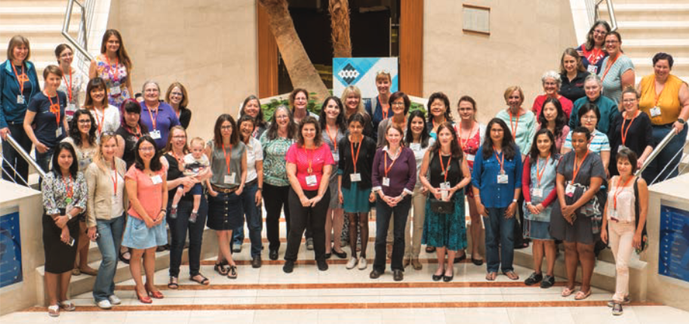
The IETF Meeting week
Organized events include:
Working Group sessions: ~130 working groups
Birds of a Feather sessions (BOFs)
IRTF sessions: ~7
Area-wide sessions
IETF-wide plenaries
Hackathons (Code Sprints, etc)
Tutorials & Lunch Sessions
Social Events
Notes:
A lot is happening during an IETF meeting week. You can get overwhelmed easily.
Three IETF meetings per year with ~1000-1500 people per meeting.
Here is a list of the types of events or session you can find during an IETF week (go through the list).
Unless noted, all sessions are open to everyone! You do not have to register (except for the systers lunch so we know how many women to expect).
Foto of a systers lunch

Slide 18
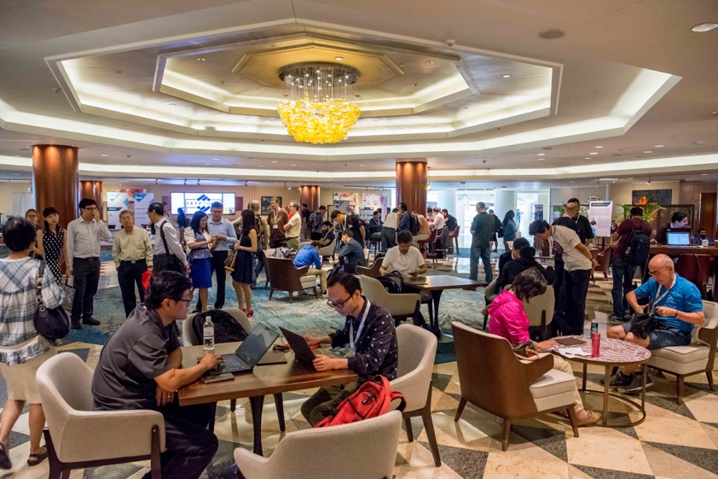

IETF Meeting week (cont)
Other events include:
Hallway meetings
Many Bar BOFs
Marathon Editing Sessions
The App is your friend!
The Agenda is your friend! https://datatracker.ietf.org/meeting/102/agenda.html
Notes:
There is also a lot of time for informal hallway chats and spontaneous “Bar BoFs”
We recommend you to use the app to keep track of the agenda.
We also recommend that you leave enough time to rest! Don’t try to fill your agenda completely. Otherwise you might collapse before the end of the week ;-)
Foto of a hackathon

Slide 19
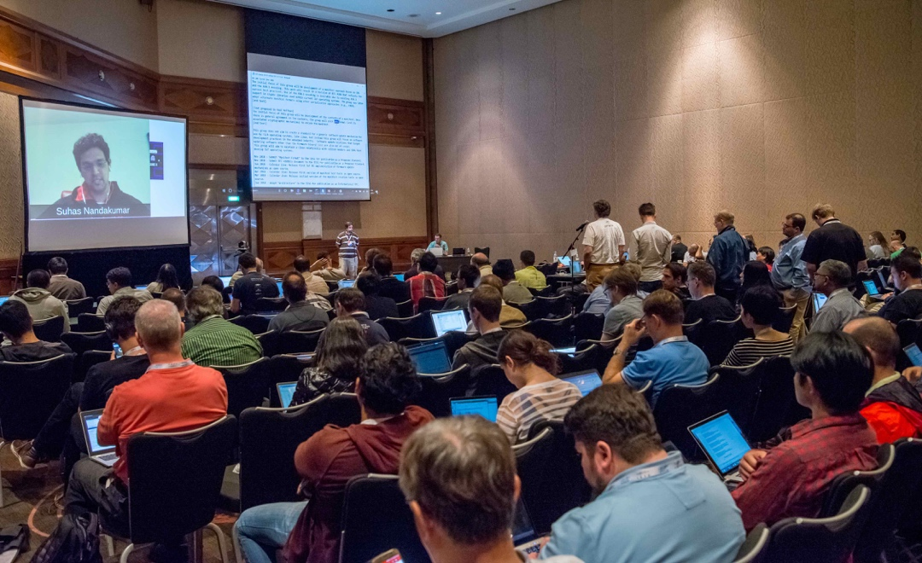
Working Groups
Where most of the IETF takes place
Most work is done on mailing lists in between meetings
Face-to-face meetings mostly focused on solving key issues
Sessions are streamed & recorded
Charter (including milestones) is negotiated with area director
Notes:
Foto of the SUIT (Software Update for Internet of Things) working group

Slide 20
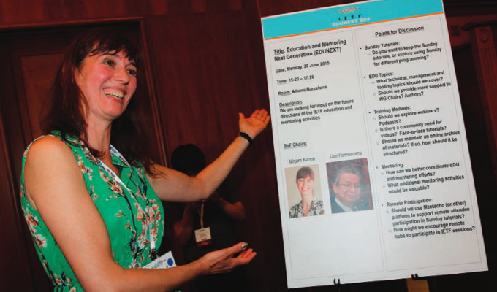
Birds-of-a-Feather (BOF)
Often precedes formation of a WG
Usually includes discussion of a proposed WG charter
Sometimes a one-shot for a timely topic
Proposed by a group interested in a topic
Approved by ADs
Generally meet only once
Notes:
Exlpain what a a BoF is and what it stands for:
“Birds of a feather flock together.” – people with the same interest in a specific topic come together and discuss that topic.
It is a requirement for setting up a WG, but there a re also “not-WG-forming BoF sessions.”
As an example for setting up a BoF: Mirjam promoting an EDU team BoF at the IETF meeting in Prague some time ago.

Slide 21
General Meeting Etiquette
Read documents of interest before WG sessions
Try to talk to people
Enjoy yourself
Remember to sleep!
Behave respectfully and tolerantly towards the other participants
Notes:
This speaks for itself.

Slide 22
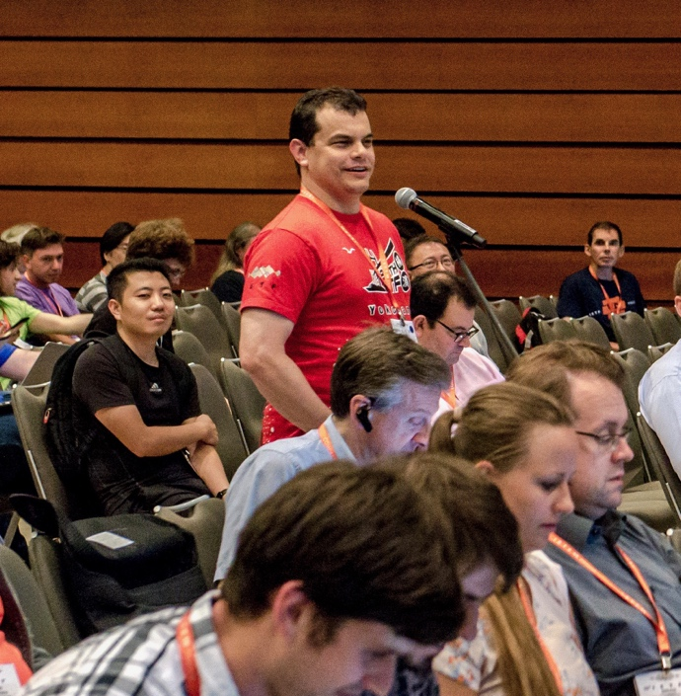
IETF Session Etiquette
Speak directly into the mic
Say your name every time you speak at the microphone
Sign the “blue sheets” which provide a record of who is in the room (remote participants recorded as well)
Listen
Technical comments & questions are welcome
Use the WG Jabber channel to discuss meeting-relevant topics
Notes:
DO:
Speak directly into the mic
Mention your name each time you speak at the mic (important for remote participants).
Sign the blue sheets (they provide a record of participation)
Listen when others speak
Use the jabber channel
DON’T:
Monopolize the microphone
Monopolize the seats
Move your bag if asked so someone can sit down.
Avoid side conversations in the meeting room
You might think you’re being quiet, but your neighbors might not.

Slide 23
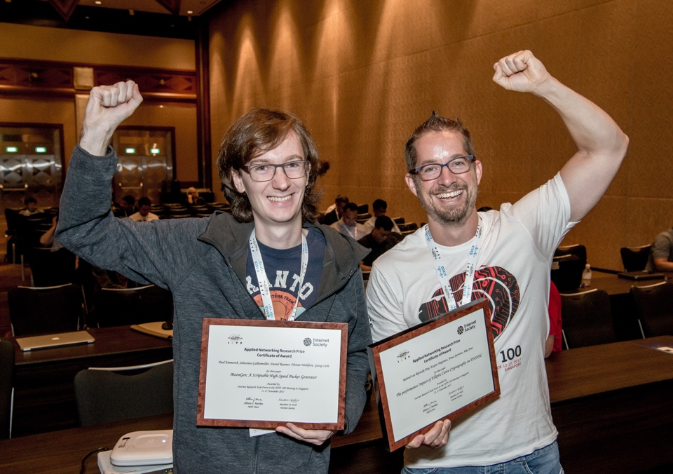
Internet Research Task Force
Officially an activity of the IAB
Looks at more “researchy” topics
IRTF RGs often meet at IETF meetings
IRTF meetings at the IETF are open to all IETF attendees
Useful reference on the IRTF: RFC 7418 “An IRTF Primer for IETF Participants” https://www.rfc-editor.org/rfc/rfc7418.txt
Notes:
The Internet Research Task Force is the sister organisation of the IETF.
It looks at more research topics, more into the future.
Some research groups (RGs) meet during the IETF week and are open to anyone.
Current topics are:
Crypto Forum
Quantum Internet
Human Rights and Standards
Measurements and analytics
Thing-to-thing

Slide 24
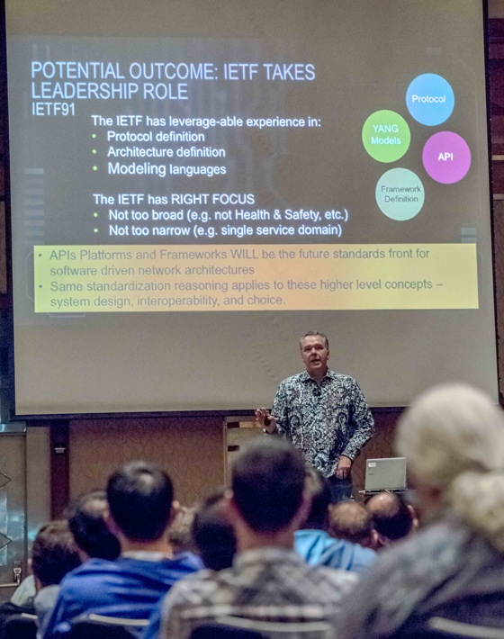
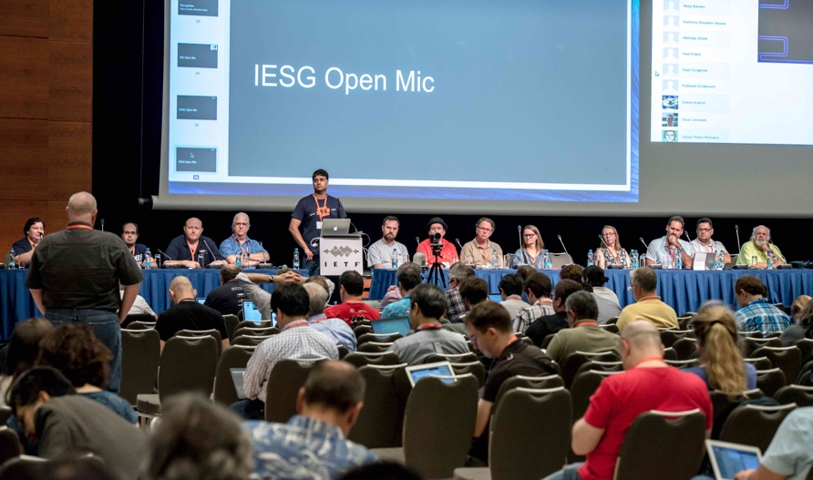
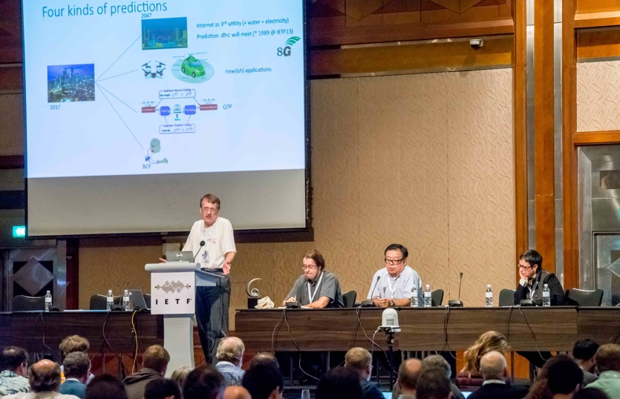
Area Sessions, Plenaries, and lunch talks
Notes:
Ares sometimes hold meetings (good opportunity to get an overview of what’s currently being discussed in an area).
There is a plenary session that usually has one or two technical presentations and lots of room for discussion. Also used for reporting form various activities.
There is usually a lunch talk organized on Thursday.

Slide 25
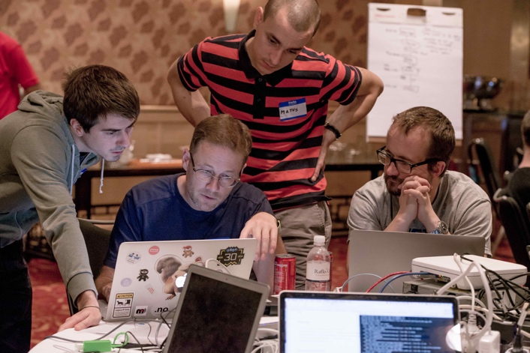
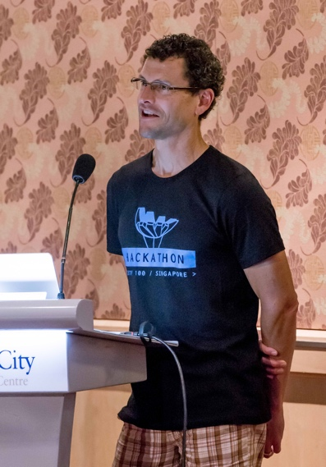
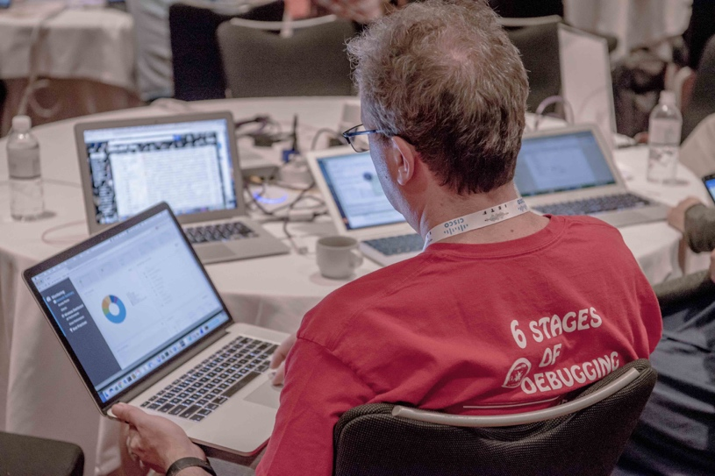
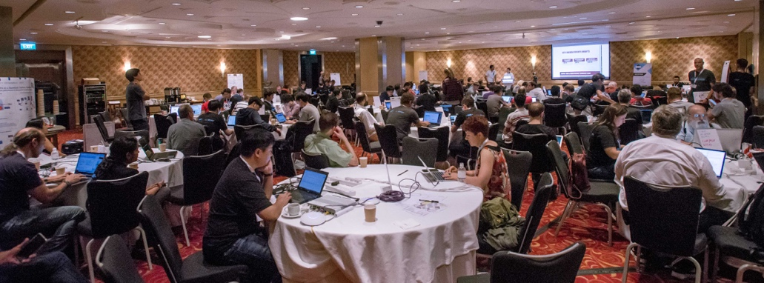
Hackathons, Code Sprints, Code Lounge
Notes:
And there is more!

Slide 26
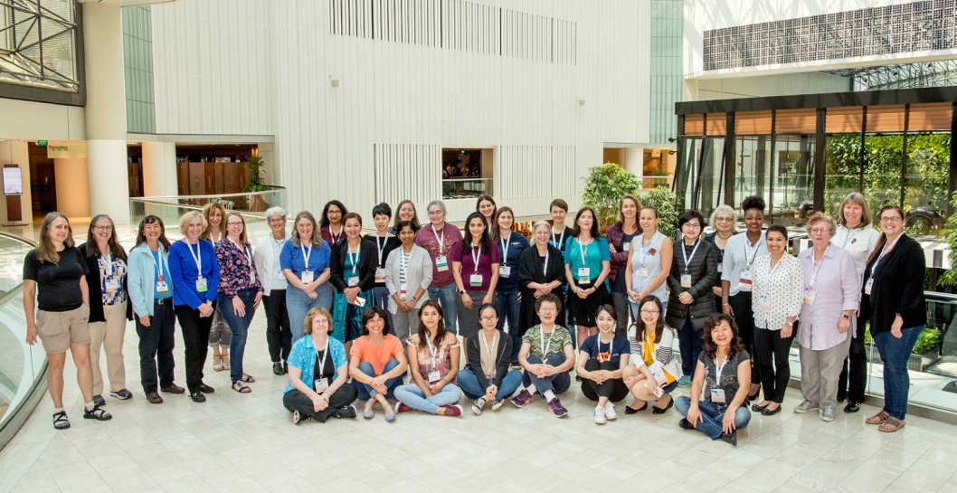
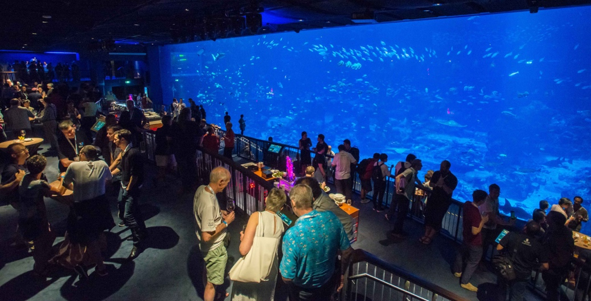
Networking and Social Events
Notes:
And please don’t forget to enjoy yourselves, to network with others and to make lots of friends.
There are social events on Tuesday evening (Note: not every IETF meeting has a social event, depends on the host and the venue).
Systers lunch on Thursday. Please subscribe to mailing list or approach one of us.

Slide 27
The Resources
People
Information
Tools

Slide 28
Key People
IETF Secretariat
RFC Editor
IANA staff
IAD
Coming Soon! Pictures!!!
Notes:
The IETF Secretariat:
We can’t hold the meeting without their help!
Permanent staff of ~10 plus registration staff
Manages the IETF meetings & provides between-meeting support
The RFC Editor:
Turns Internet-Drafts into RFCs – publication series of the IETF, IRTF, IAB and Independent Streams
The Internet Assigned Names and Numbers Authority (IANA):
Primary IETF role is parameter registrar
The IAD – IETF Administrative Director:
Not technically a group

Slide 29
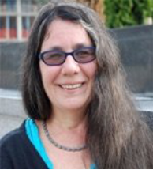
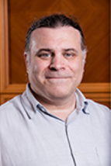
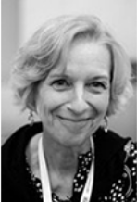
The Ombudsteam
Report any harassment to the ombudsteam (BCP 25) https://www.ietf.org/iesg/statement/ietf-anti-harassment-policy.html
Allison Mankin, Pete Resnick, Linda Klieforth
Notes:
If you experience anything unusual or anything that you don’t feel comfortable with, please do not hesitate to find any of these three friendly people.
All reports will be handled with strict confidence.

Slide 30

Dots & Ribbons (Who’s Who!)
Working Group Chair
Internet Research Group (IRSG) Member
Nominations Committee
RFC Series Editor
Internet Engineering Steering Group (IESG) Member
IETF Administration and Oversight Committee (IAOC) Member
Internet Architecture Board (IAB) Member
TBD (WG)
OMBUDSTEAM
NEWCOMER
HOST
Notes:
You will see some people with colored dots or ribbons on their badge.
You as a Newcomers will have a red-brown ribbon stating that you are a newcomer (so that people are gentle to you :-))
Here you can see the meaning behind all the dots and ribbons. But please don’t hesitate to ask people what their roles are.

Slide 31
Meeting Specific Links
Tutorials:
https://www.ietf.org/about/participate/tutorials/
Meeting wiki:
https://trac.ietf.org/trac/ietf/meeting/wiki/ietf103

Slide 32
More Meeting Resources
First-time attendees mailing list:
https://www.ietf.org/mailman/listinfo/103-newcomers
IETF Systers
https://www.ietf.org/blog/ietf-systers/
Meeting mailing lists:
https://www.ietf.org/how/meetings/ietf-meeting-mailing-lists/
(social lists, travel companions, meeting participants)
Notes:
Newcomers’ page https://www.ietf.org/about/participate/get-started/

Slide 33
Information
IETF Datatracker https://datatracker.ietf.org/
Tools Page https://tools.ietf.org/

Slide 34
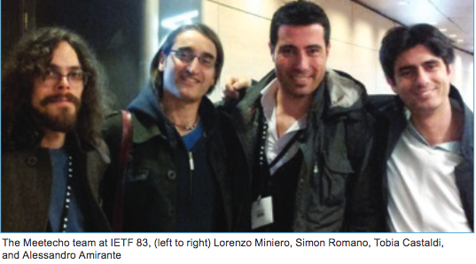
https://www.ietf.org/how/meetings/103/remote Remote Participation
Attendance at face-to-face IETF meetings is not required.
IETF supports remote attendance capabilities for all WG sessions.
Meetecho is the tool for remote participation!
Notes:
https://www.ietf.org/how/meetings/103/remote/

Slide 35
https://tickets.meeting.ietf.org/wiki/IETF103network The Network @ IETF
The IETF runs its own network (including sometimes the primaryhotel)
Generally up by early Saturday and down around noon on Friday
There are a number of wireless SSIDs available
Avoid ietf-legacy if possible. It is unencrypted (enough said...)
Secure networks use userid: “ietf” and password: “ietf”
There’s also a terminal room with no terminals, but with printers and wired connectivity – AND PEOPLE WHO CAN HELP!

Slide 36
Jabber
The IETF uses eXtensible Messaging and Presence Protocol (XMPP) [RFC 6120] to host a number of chat rooms during the IETF meeting.
Get a client: http://xmpp.org/software/clients.html
Register an account: https://list.jabber.at/
Join a chat room, usually: <wgname>@jabber.ietf.org
Used to ask questions and provide a hint of where the discussion is at on slides for audio remote listeners.

Slide 37
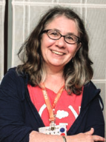

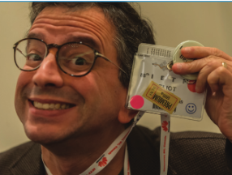
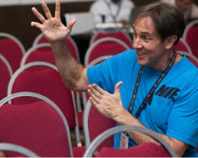
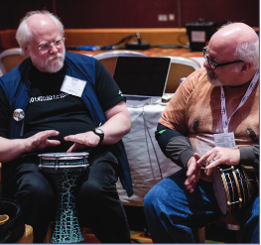
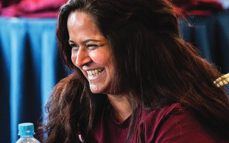
Above all: Enjoy!

Slide 38
https://www.surveymonkey.com/r/102newcomers Questions or Feedback?
What did we miss?
Please help us help you - answer our survey! https://www.surveymonkey.com/r/103newcomers
Contact us at edu-team@ietf.org
Photos © Stonehouse Photographic/Internet Society

